Slide 1
"Risk Mitigation through EDA: Unveiling Patterns in Client Payment Behavior for Informed Lending Decisions in Banking Sector"
Prepared by Poojit Kasina
Data analyst Trainee and intern at Oeson
Intern Code: OGTIPDAPA230
Mentor: Ms Smruthi Metha

Slide 2
CONTENTS
Introduction
Identifying the Problem Statement
Data Overview
Analysis Approach
Detecting the outliers
Data Pre-processing Steps
Univariate Analysis
Bivariate Analysis
Multivariate Analysis
Conclusion

Slide 3
Introduction
The purpose of this case study is to identify patterns that indicate if a client may have difficulty paying their instalments.
These patterns can be used to take actions such as denying the loan, reducing the amount of the loan, or lending to risky applicants at a higher interest rate.
The goal is to ensure that only those capable of repaying the loan are approved. This case study aims to identify such applicants using EDA.

Slide 4
Identifying The Problem Statement
Problem statement:
Loan defaults are a major challenge for lenders, leading to financial losses and reputational damage.
It is important to be able to identify borrowers who are at a higher risk of defaulting on their loans.
Solution:
This case study uses exploratory data analysis (EDA) to identify patterns in loan data that indicate loan default.
The goal is to develop a predictive model that can be used to identify borrowers who are at a higher risk of defaulting on their loans.
Benefits:
By identifying borrowers who are at a higher risk of default, lenders can make more informed decisions about which borrowers to approve and at what interest rate.
This can help lenders to reduce their risk and improve their profitability.
Call to action:
This case study will present the findings of the EDA and discuss the implications for loan default prediction.

Slide 5
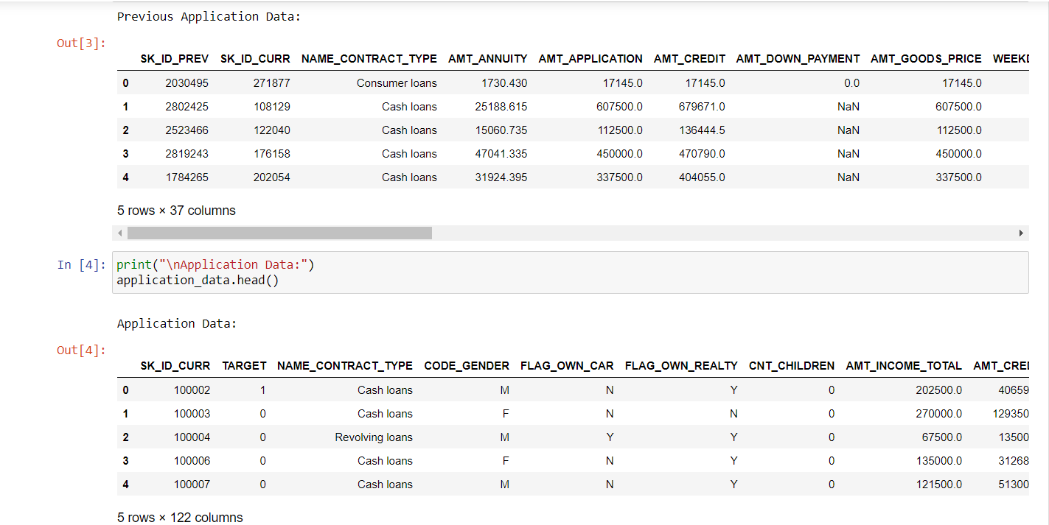
Data Overview
Previous_application.csv: This Excel file provides data regarding the client's past loan transactions.
Application_data.csv: This Excel document provides detailed information about the client at the point of their loan application.

Slide 6
Analysis of Approach
Analysis of Decisions in the Loan Application Process
Approved: Company approval of the loan application.
Cancelled: Client withdrawal, possibly due to changing circumstances or unfavourable terms.
Refused: Loan denial based on factors like noncompliance with requirements or risk assessment.
Unused Offer: Clientinitiated cancellation at different stages.
Analysing these decisions defines the understanding of clientcompany interactions, shedding light on the nuances of the loan approval journey.“
I have performed Univariate Analysis, BiVariate Analysis and MultiVariate Analysis depending of the situation

Slide 7
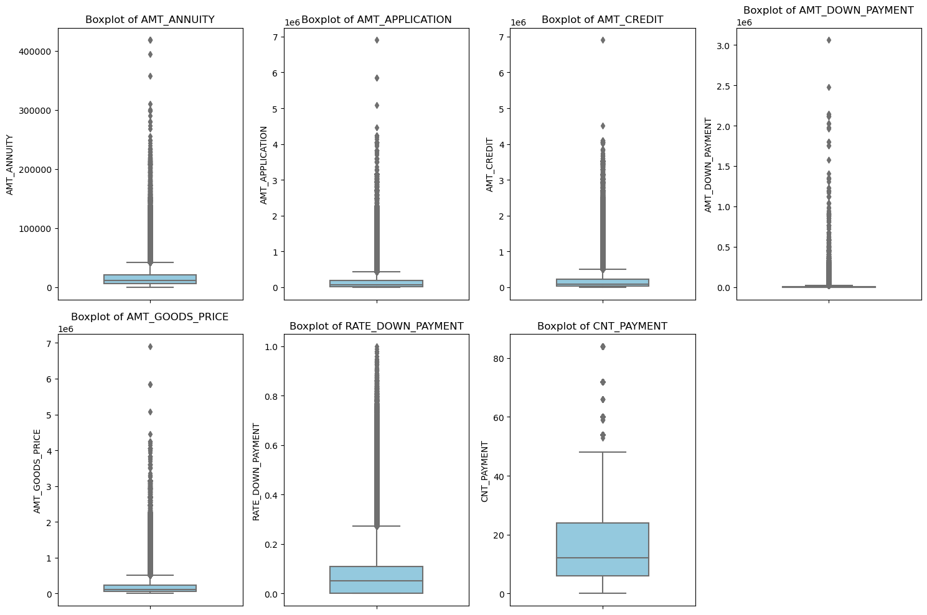
Detecting outliers
Wide variation in all four variables (AMT_ANNUITY, AMT_APPLICATION, AMT_CREDIT, and AMT_DOWN_PAYMENT).
Some outliers in the data.
Median AMT_ANNUITY is around 100,000.
Median AMT_APPLICATION is around 10,000.
Median AMT_CREDIT is around 300,000.
Median AMT_DOWN_PAYMENT is around 100,000.
Strong correlation between AMT_ANNUITY and AMT_CREDIT.

Slide 8
Data Preprocessing Steps
Imported necessary libraries such as NumPy, Pandas, Matplotlib, Seaborn
Merging Data frames: Merged data from two different data frames (`application_data` and `previous_application_data`) using a common key (`SK_ID_CURR`).
Handling Null Values:
Checked for missing values in the merged data.
Imputed missing values in numerical columns with the median.
Imputed missing values in categorical columns with the mode.
Handling Specific Values: Replaced specific values ('XNA' and 'XAP') in the 'CODE_GENDER' column with the mode
Subset Data for Analysis: Selected specific columns for analysis, including variables like income, credit, annuity, and time-related features.
Correlation Analysis: Calculated and visualized the correlation matrix using a heatmap for selected variables.

Slide 9
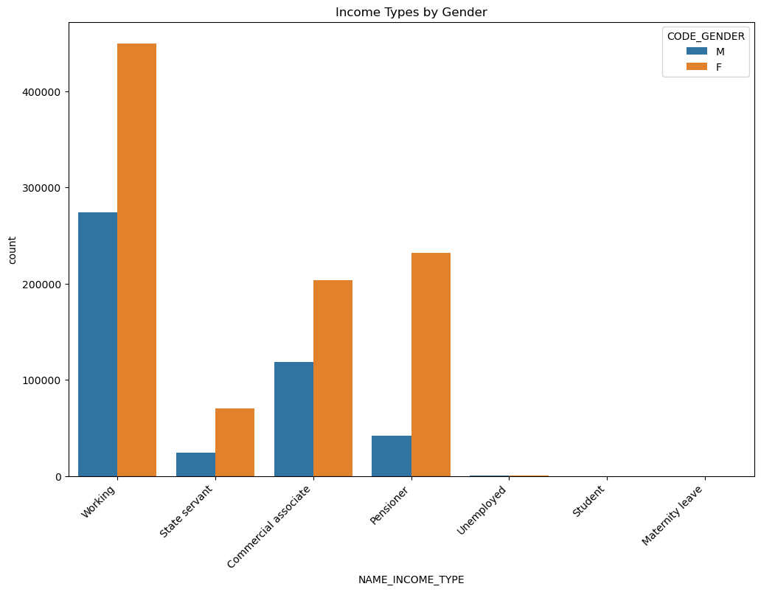
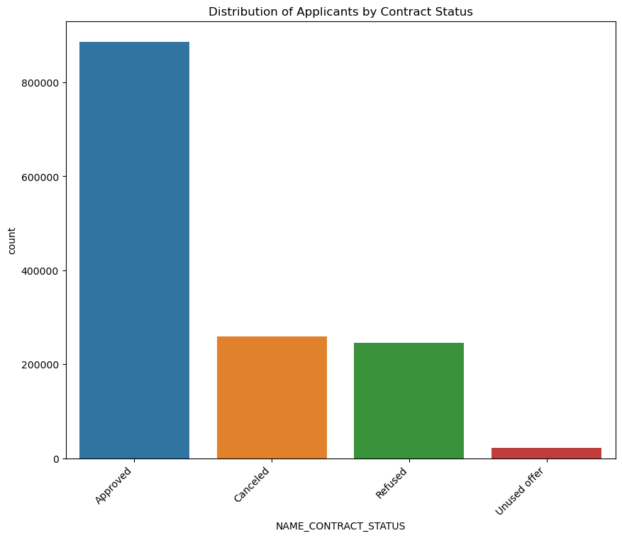
Univariate Analysis
Men consistently earn higher incomes than women across all categories.
Top earning category for men: "Working," followed by "Commercial associate" and "State servant."
Top earning category for women: "Working," followed by "State servant" and "Commercial associate."
A majority (over 60%) have approved contract status.
Unused offers: Around 20%.
Cancelled contracts: Around 10%.
Refused contracts: Around 10%.

Slide 10
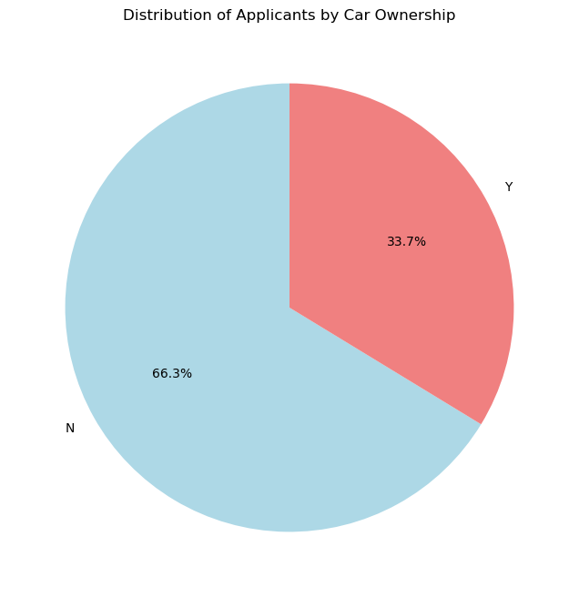
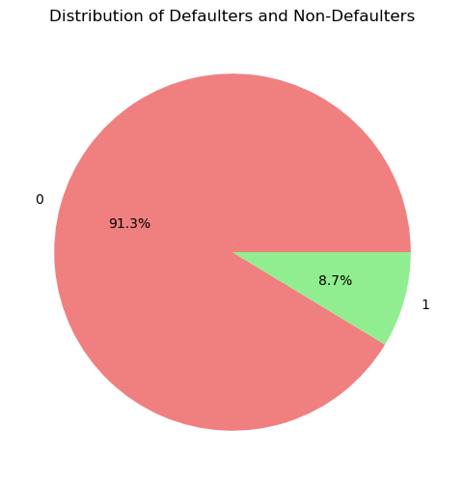
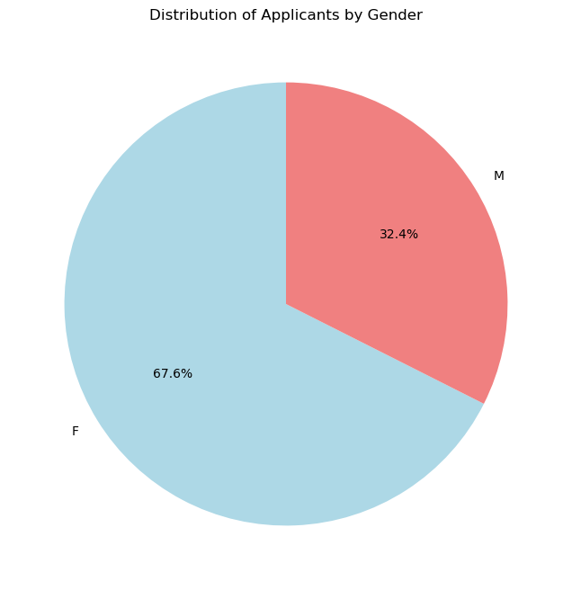
Univariate Analysis
Most Clients Don't Have a Car: 66.3% of clients don't own a car, which is a big majority.
Credit Applications: When looking at clients asking for credit, it's important because not having a car might mean fewer financial responsibilities.
Variable TARGET indicates if an applicant has payment difficulties (1) or not (0).
Applicants with payment difficulties may default on loan repayments.
Pie charts show that 91.9% are non-defaulters while 8.1% are still Defaulters
Applicant Distribution: Majority (over 60%) have approved contract status, showcasing successful conversion.
Areas for Improvement: Unused offers (around 20%) and cancelled contracts (around 10%) highlight opportunities for enhancing conversion rates.

Slide 11
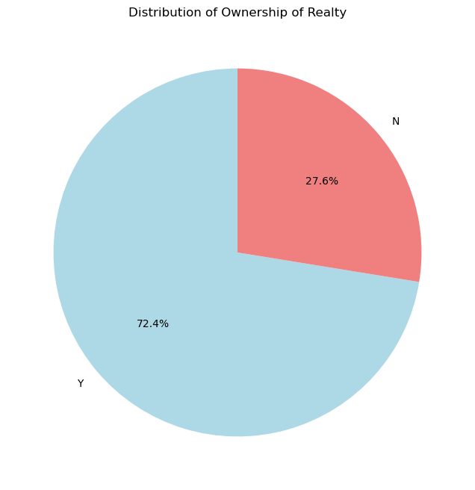
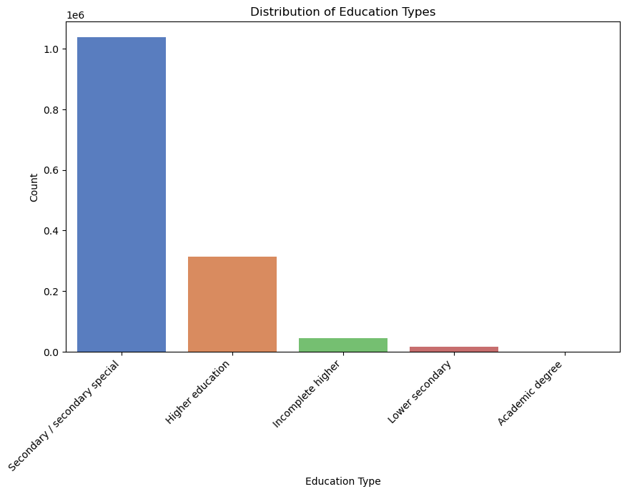
Uni-variate Analysis
The data shows that 72.4% of eligible loan applicants own property, giving them a higher chance of approval.
Applicant’s Marital Status:
Predominantly, loan applicants are married.
Noteworthy, there are applicants who are single, in civil marriages, or widowed applying for loans.

Slide 12
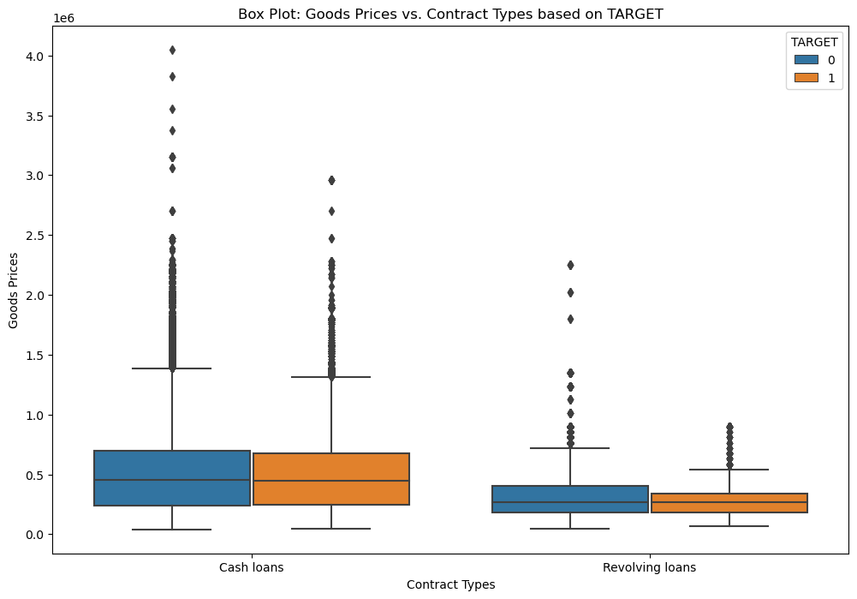
Bi-variate Analysis
Goods prices in banking transactions tend to be higher than contract types based on the target.
Higher variability in goods prices may be due to market fluctuations, while contract types based on the target exhibit more stability.
Presence of outliers in goods prices suggests potential individual factors, impacting decisions related to pricing, inventory management, and marketing in banking operations.

Slide 13
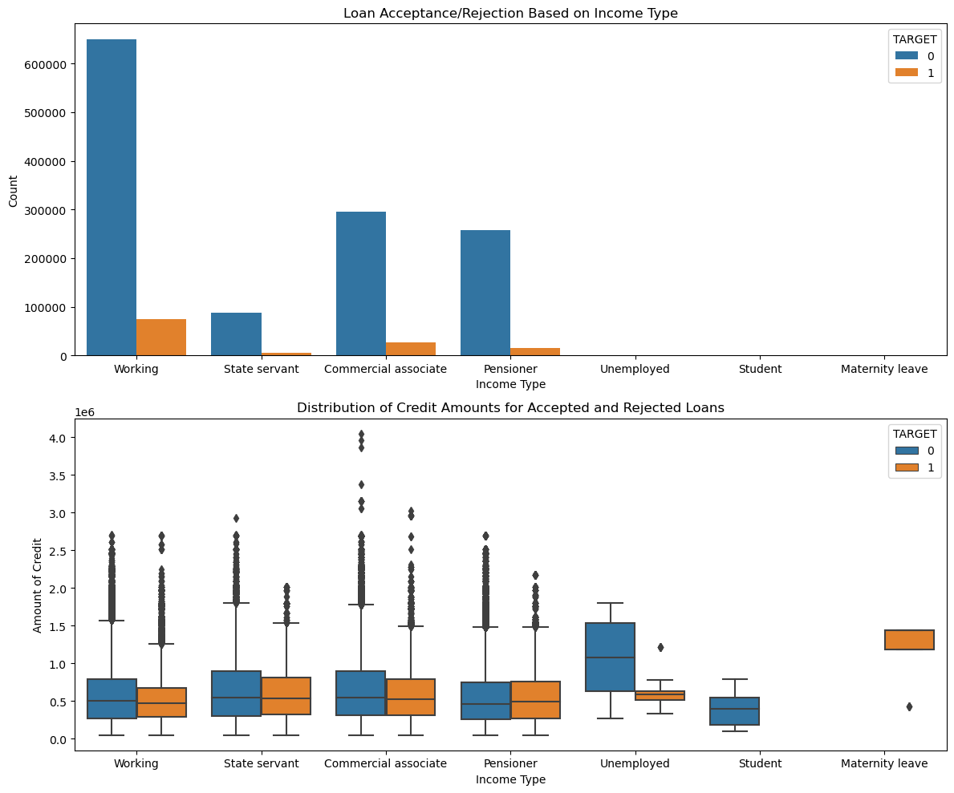
Bi-variate Analysis
Higher incomes increase chances of getting loans and larger credit amounts, indicating better creditworthiness.
Lower incomes result in higher loan rejection rates, reflecting financial risk.
Loans tend to be concentrated among a smaller group of higher-income earners.
Lenders exercise caution with lower-income applicants.
Unemployed and student applicants have the lowest acceptance rates, presenting an opportunity for lenders to refine practices to meet diverse needs.".

Slide 14
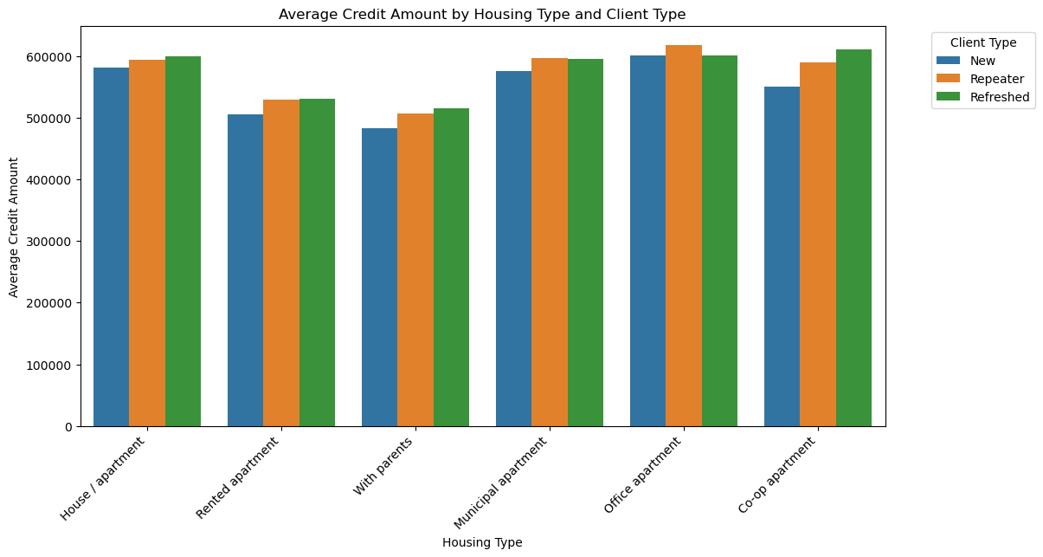
Bi-variate Analysis
People who own single-family homes/apartments have the highest average credit amount.
There is a large variation in credit amount within each housing type.
New and refreshed clients have higher average credit amounts than repeater clients.
There is a positive correlation between homeownership and credit amount.
Credit amount is also influenced by other factors, such as income, age, and credit history. apartment

Slide 15
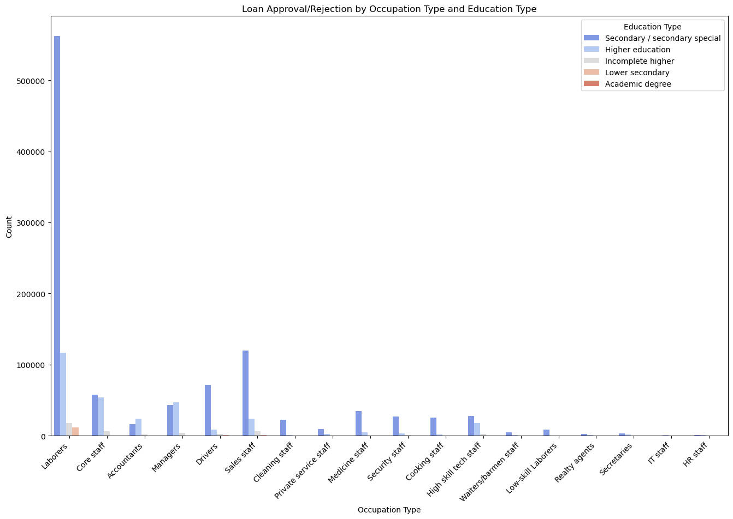
Bi-variate Analysis
People with higher education levels and higher-skilled occupations are more likely to have their loans approved.
This is likely because lenders perceive these borrowers as being more likely to be able to repay their loans.
However, it is important to note that there are other factors, such as credit score and debt-to-income ratio, that also influence loan approval rates.

Slide 16
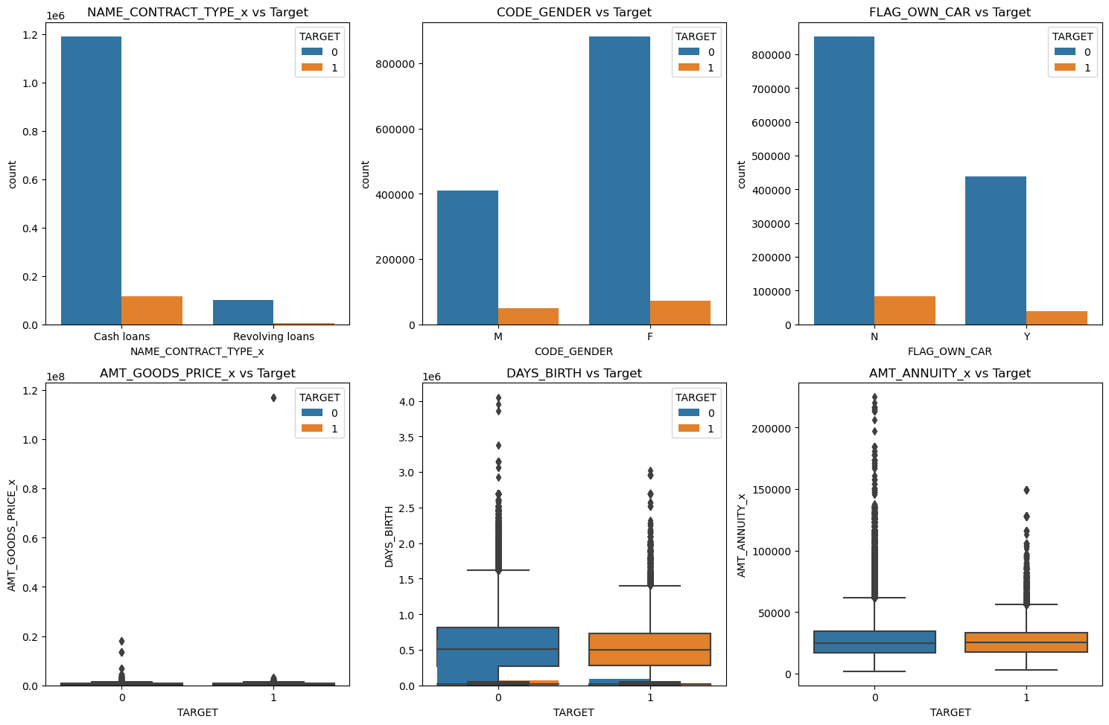
Bi-variate Analysis
Analyzing the Categorical columns and numerical columns Based on Target
NAME_CONTRACT_TYPE: The target variable is higher for cash loans than for revolving loans.
CODE_GENDER: The target variable is higher for males than for females.
FLAG_OWN_CAR: The target variable is higher for people who own a car than for people who do not.

Slide 17
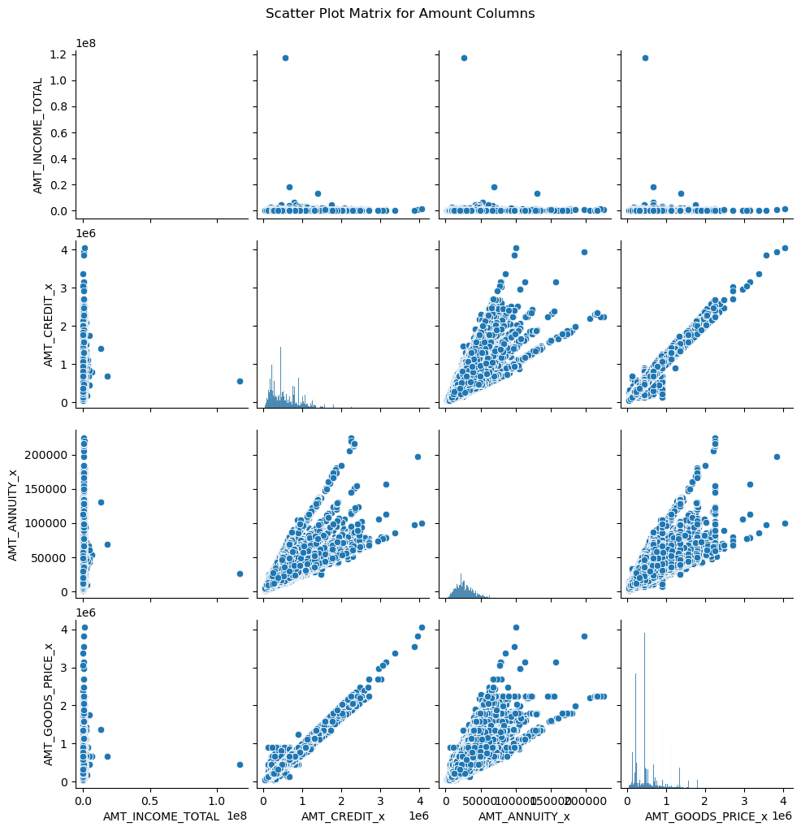
Bi-variate Analysis
The scatter plot matrix shows the relationship between key numerical variables of Amount Category columns
Higher total income correlates with larger credit limits.
Higher income may lead to higher annuity payments and more expensive goods.
These financial decisions are interconnected, and understanding them helps make better decisions in areas like loan approval and pricing strategies.

Slide 18
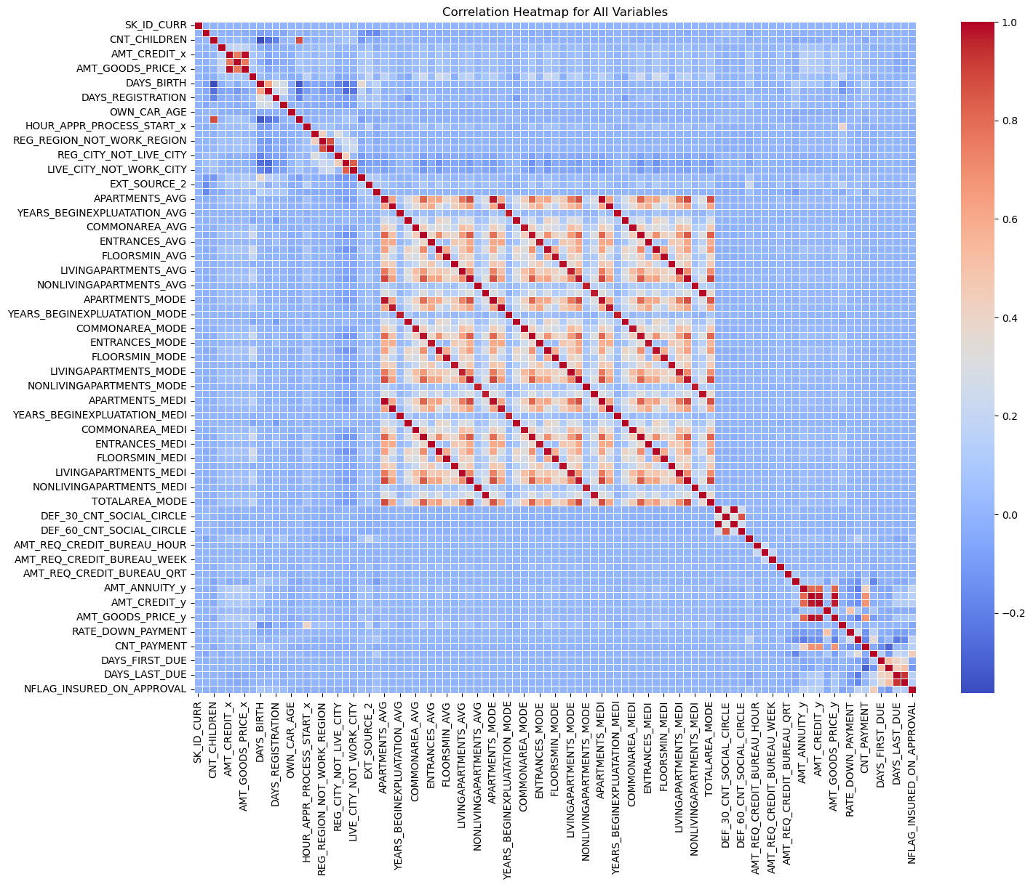
Multi-variate Analysis
The heatmap shows how variables in the dataset are correlated.
The correlation coefficient ranges from -1 to 1, with 1 indicating a perfect positive correlation, -1 indicating a perfect negative correlation, and 0 indicating no correlation.
For example, there is a strong positive correlation between the variables AMT_CREDIT_Y and AMT_GOODS_PRICE_Y, indicating that borrowers who borrow more money tend to buy more expensive goods. There is also a strong negative correlation between the variables CNT_PAYMENT and NFLAG_INSURED_ON_APPROVAL, indicating that borrowers who make more payments are less likely to have their loans insured.

Slide 19
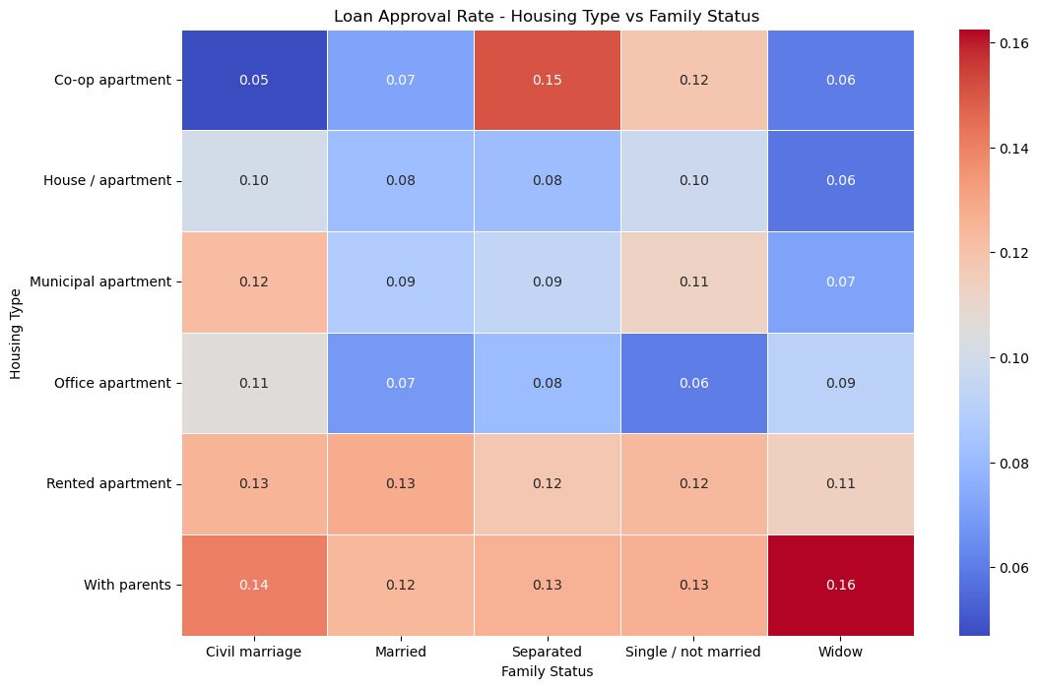

Slide 20
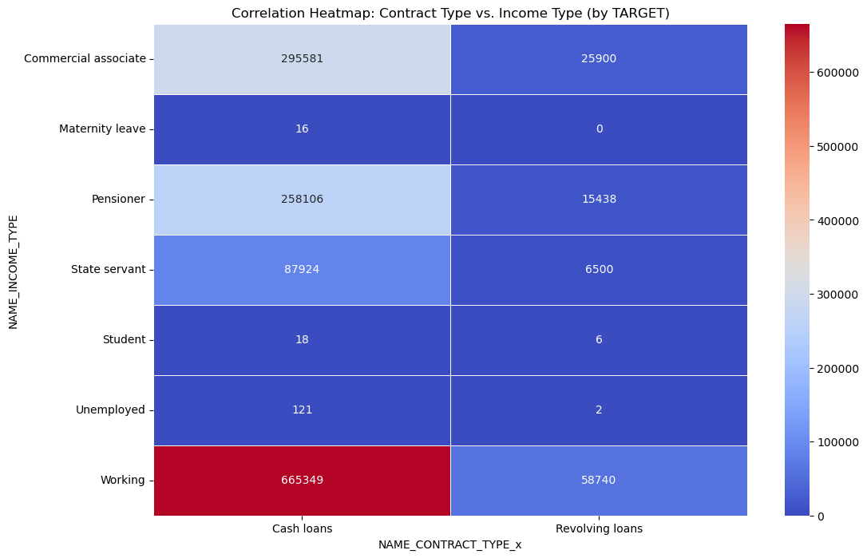

Slide 21
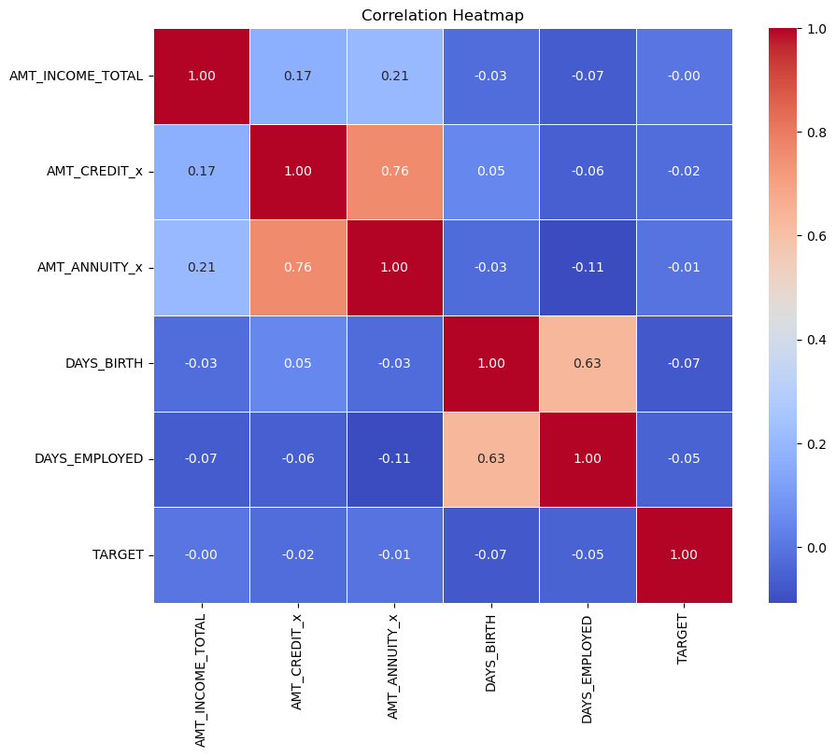

Slide 22
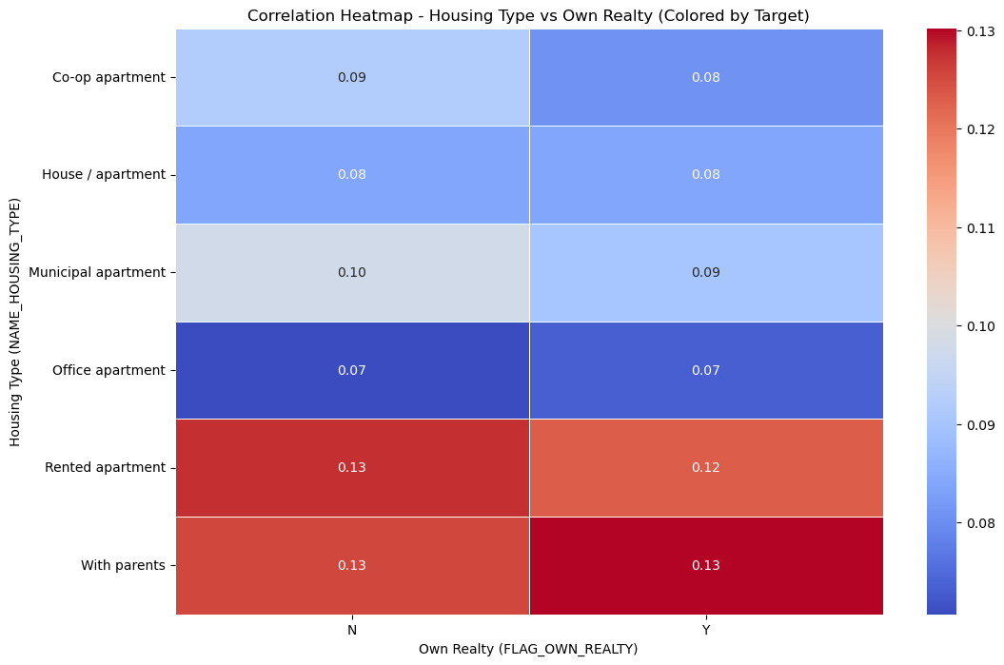

Slide 23
Conclusion
Target Demographics:
- Businessmen and Students: Identified as more profitable segments for targeted banking services.
- Females: Indicated as potentially better clients, suggesting a focus on catering to female demographics.
Loan Portfolio Strategy:
- Mobiles and Electronics: Emphasizes a strategic focus on credit offerings for these products.
- Cash Loans: Recognized as the most popular loan type, suggesting potential for tailored products.
Asset Ownership and Marital Status:
- Car Ownership: Highlighted that most clients do not own cars, informing potential financing options.
- Marital Status: The majority of clients being married indicates potential for family-centric financial products or services.

Slide 24


